Slide 1
Artivism for PSEA Shila Bhatta Freedom Studio

Slide 2
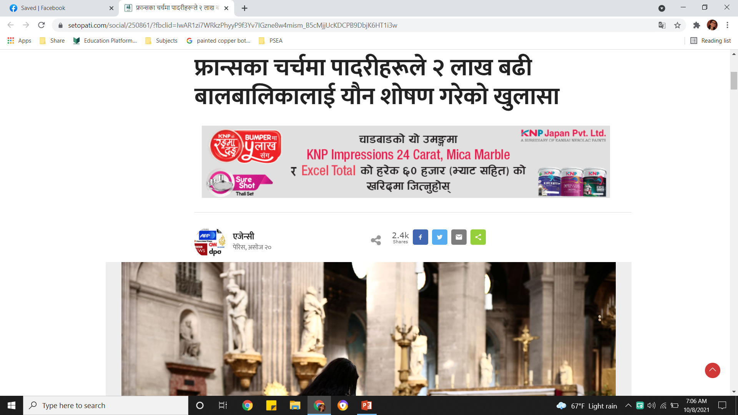

Slide 3
Sexual Exploitation and Abuse
Sexual Exploitation : Actual or attempted abuse of a position of vulnerability, power, or trust, for sexual purposes, including, but not limited to, profiting monetarily, socially or politically from the sexual exploitation of another.
Sexual Abuse : Actual or threatened physical intrusion of a sexual nature, whether by force or under unequal or coercive conditions.
SEA occurs when a position of power is used for sexual purposes against a beneficiary or vulnerable member of the community.
We understand SEA as acts perpetrated by aid workers or people associated with aid organisations against the people that they are supposed to protect or provide aid to.

Slide 4
Vulnerable groups
Children
Women
Person living with disability
Elderly People
Why??

Slide 5
Human Rights and Protection
Human/ Child Rights are rights inherent to all human beings, regardless of race, sex, nationality, ethnicity, language, religion, or any other status. Children and young people have the same general human rights as adults and also specific rights that recognize their special needs. UDHR CRC
Protection: all activities aimed at ensuring full respect for the rights of the individual in accordance with the letter and the spirit of the relevant bodies of law, i.e. human rights law, international humanitarian law, and refugee law
Child Protection: All policies, strategies and actions to prevent and respond to abuse, violence, exploitation and neglect

Slide 6
What is PSEA?

Slide 7
What is Child safe programming?

Slide 8
What is Child Friendly programming?

Slide 9
What is gender sensitivity?

Slide 10
Messaging through art products

Slide 11
Messages focusing on humanitarian organizations and workers
Six Core principles of PSEA
Steps and Guidelines for PSEA policy
Complaint and Response mechanism
Child safety and Child friendly approach
Confidentiality

Slide 12
Messages focusing on the beneficiary communities
General Information on Sexual Exploitation and Abuse
Complaint/ reporting mechanism within the organization
Other complaint mechanisms
Technical knowledge to be safe from online sexual exploitation and abuse

Slide 13
Things to consider while producing artwork
Tailored to the local cultural contexts (Focusing on major ethnic and religious contexts from three geographical reasons i.e. Himal, Pahad, and Terai) Incluveness
The groups that are most at risk (accessible, understandable, simple )
Languages diversity (Nepali, Maithali, Bhojpuri, Abadi, Dyotali, Tamang)
Cultural sensitivity

Slide 14
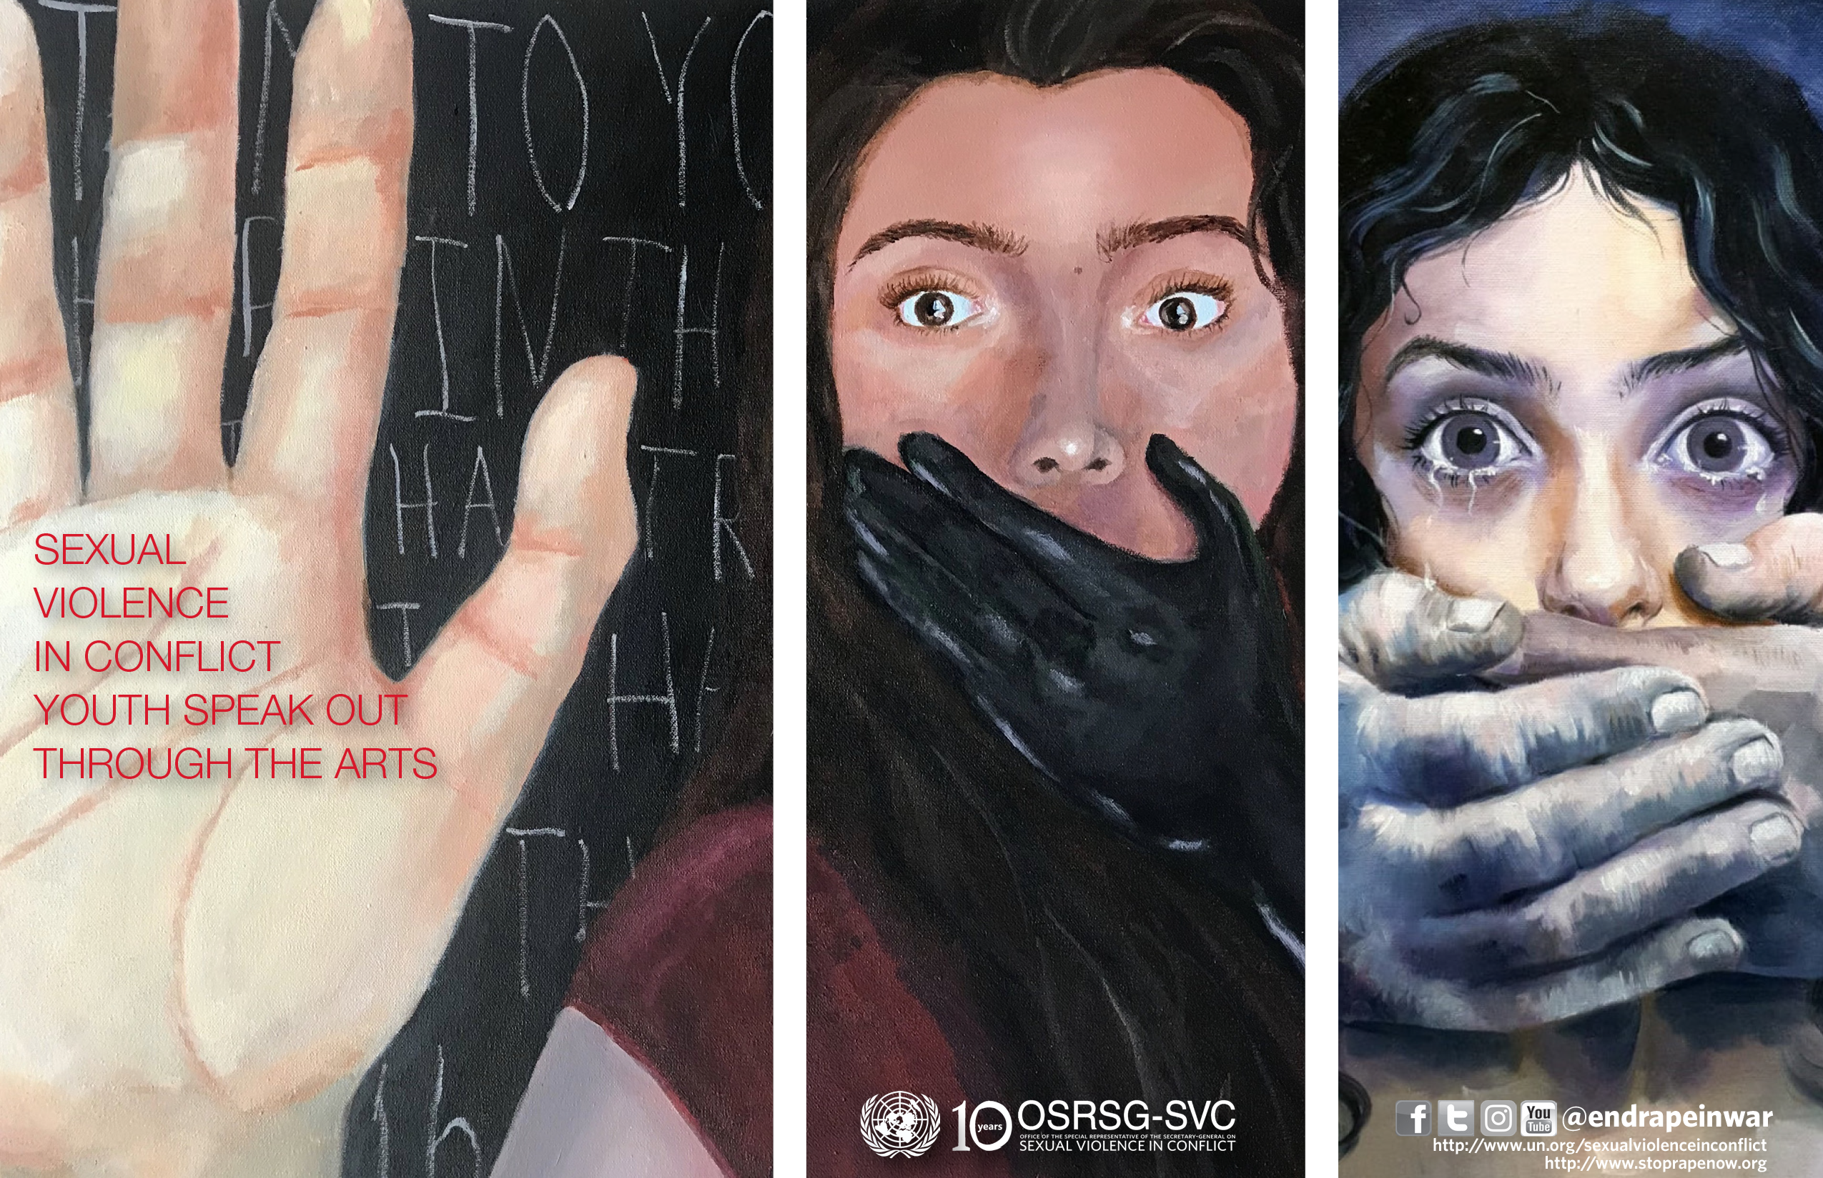

Slide 15
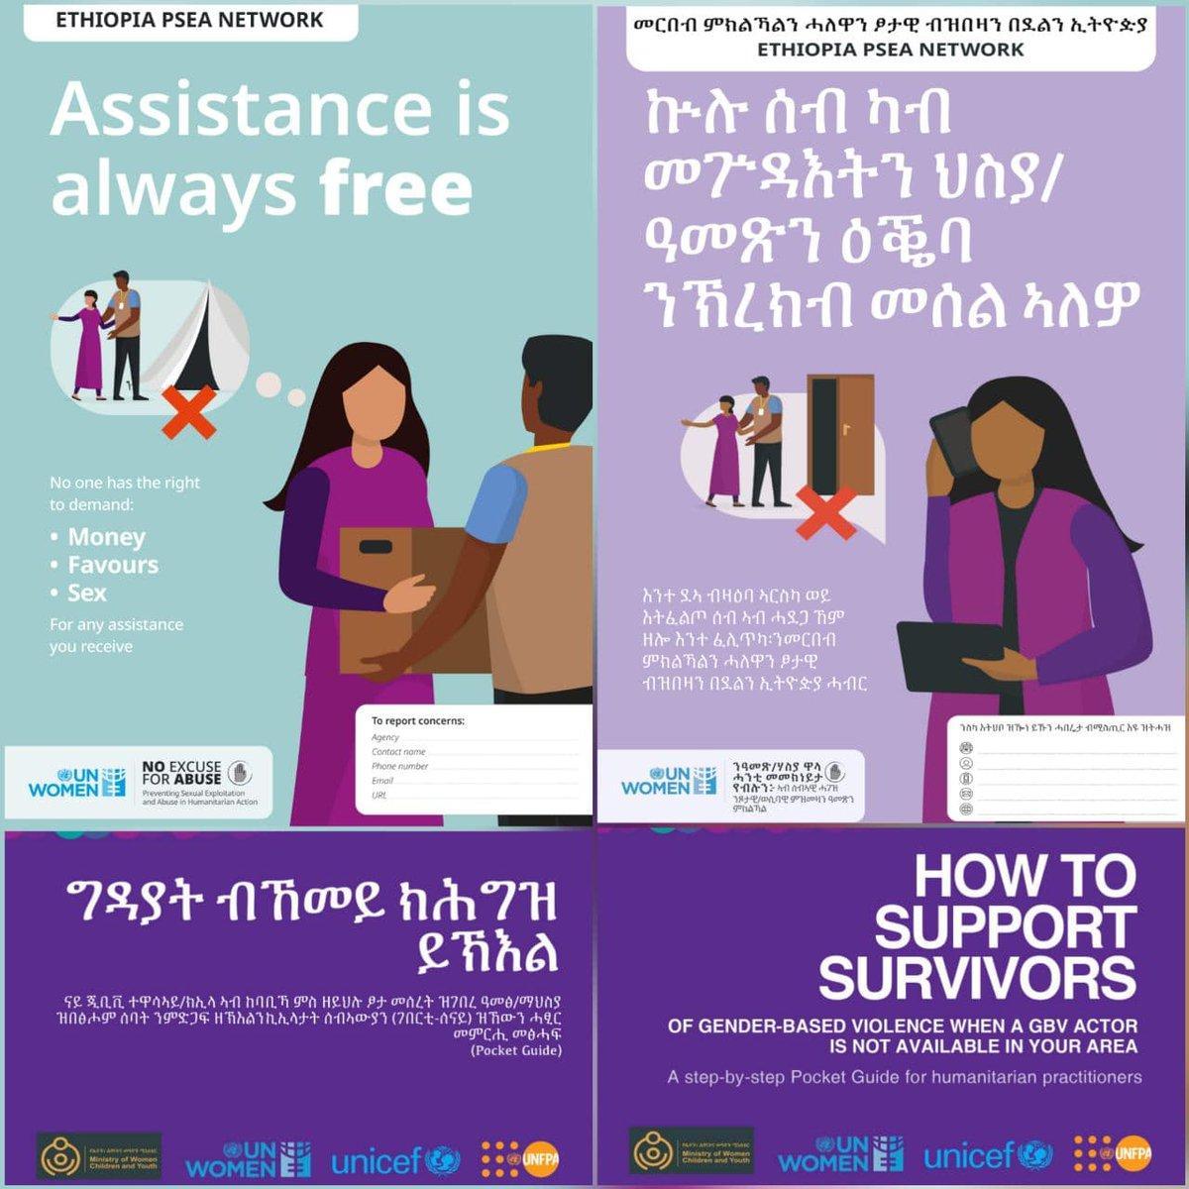

Slide 16
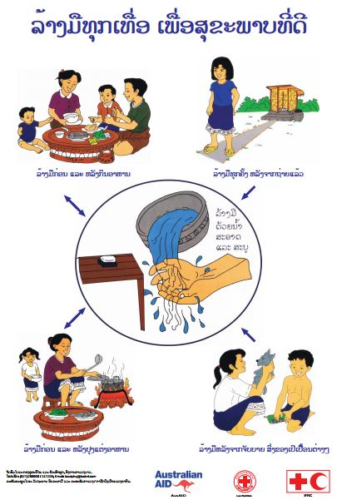

Slide 17
DEMOS
https://www.youtube.com/watch?v=48MCG22FqrE
https://www.youtube.com/watch?v=ZvR4GPpeUfw

